Slide 1
NLP & MACHINE LEARNING
Resume Classification
Automated talent screening and role categorization using Natural Language Processing.
Search Repositories / tmthangaraj1980-AIML

Slide 2

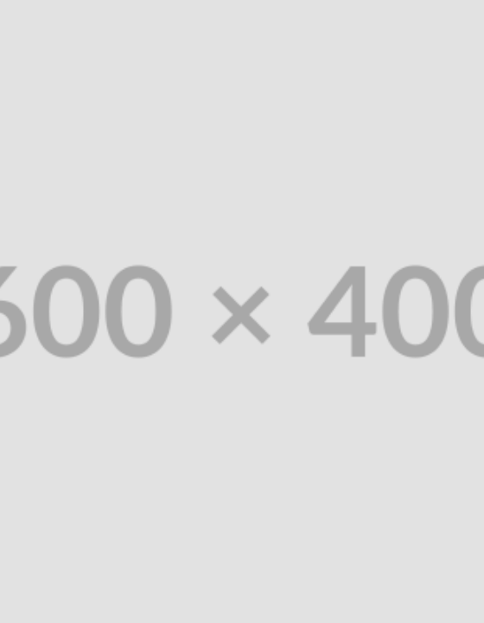
THE PROBLEM
The HR Bottleneck
Manual Screening: Recruiters spend hours parsing unstructured text.
Human Bias: Inconsistent evaluation criteria across reviewers.
Format Chaos: Infinite variations in layout, vocabulary, and file types.

Slide 3



System Objectives
Text Extraction
NLP Cleaning
Role Classification
Robust parsing of raw PDFs and DOCX files.
Lemmatization, stop-word removal, and tokenization.
Map unstructured text to predefined job categories.

Slide 4






NLP Stack
Python
spaCy / NLTK
Scikit-Learn
PyPDF2
Pandas
Regex

Slide 5
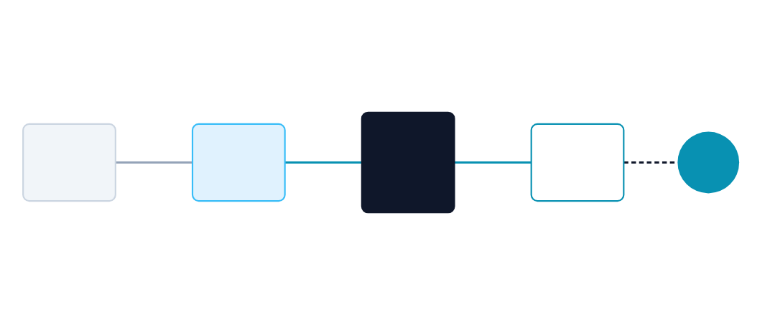
Classification Architecture
TF-IDF
Vectorizer
Raw Resume
Corpus
Text Cleaning
& Tokenization
ML Classifier
Model
Job
Role

Slide 6
NLP Pipeline
1. Ingest
2. Clean
3. Vectorize
4. Classify
Extract string from PDF.
Regex removes emails & URLs.
Convert tokens to numeric matrices.
Model assigns domain category.

Slide 7
Dataset & Preprocessing
The Corpus
Text Normalization
Kaggle / Open-source resume dataset.
Stopword removal (the, is, and).
Labeled by domain (IT, Finance, HR).
Lemmatization (running → run).
Class balancing applied via SMOTE.
Lowercase conversion and punctuation strip.

Slide 8
Core ML Algorithms
TF-IDF Vectorization
Classification Model
Term Frequency-Inverse Document Frequency
Random Forest / SVM / KNN
Evaluates word importance mathematically, downweighting common words and prioritizing domain-specific skills (e.g., "Python", "GAAP").
Supervised learning model trained on the vectorized matrix to define decision boundaries separating distinct job categories.

Slide 9
MODEL PERFORMANCE
Testing Metrics
98%
0.97
Global Accuracy
Macro F1-Score

Slide 10
Challenges & Limitations
Parsing Challenges
Future Improvements
Complex Layouts Multi-column resumes confuse standard top-down PDF parsers.
Word Embeddings Transitioning from TF-IDF to Word2Vec or BERT for semantic context.
Implicit Skills TF-IDF misses contextual skills not explicitly named in the text.
Named Entity Recognition (NER) Extracting exact entities (Degree, Org, Years of Exp).

Slide 11
Technical Q&A
1. TF-IDF vs Word Embeddings (Word2Vec)?
4. Precision vs. Recall in resume screening?
TF-IDF represents term frequency but ignores semantic meaning and word relationships.
High recall is preferred so no good candidate is missed, leaving final filtering to humans.
2. How to handle class imbalance in HR data?
5. Dealing with Out-Of-Vocabulary (OOV) words?
Use SMOTE to oversample minority classes or adjust class weights in the classifier.
Subword tokenization (like BPE used in BERT) handles OOV by breaking them into known chunks.
3. Why remove stopwords?
Reduces dimensionality and noise, allowing the model to focus on domain-specific keywords.

Slide 12

Data-Driven Talent Discovery.
Scaling HR operations through intelligent natural language processing.
/tmthangaraj1980-AIML
tmthangaraj1980

Slide 13

Image Sources
https://repository-images.githubusercontent.com/396035212/8b111666-419f-431f-bef9-1dcfda6efcd0
Source: github.com
https://cdn.dribbble.com/userupload/45788503/file/b1676f6d71c218be5825d216432d1398.png?resize=752x&vertical=center
Source: dribbble.com
https://www.superannotate.com/c/52_13_d9d5926ec1.png
Source: www.superannotate.com

